Slide 1
”DIKSHA” Sundaram Fin.Tech 2025
Journey Presentation –week 9
Anil Rasa
Date : 13-Apr-2025

Slide 2

Topics Covered in Ninth Week !

Slide 3
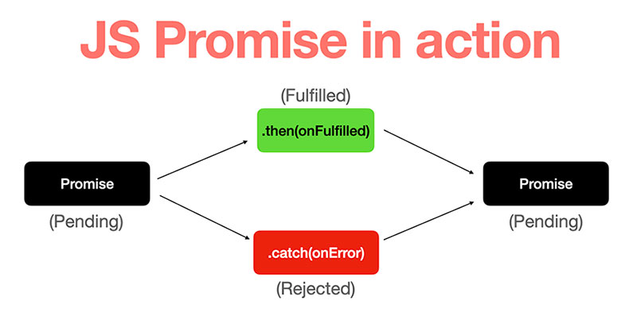
Learning 1 | My takeaways
→React Testing(JEST,RTL)
→ARIA
→Promises
→Hooks(UseSlector,UseDispacher)

Slide 4
Hooks(UseSlector,UseDispacher)
*React-Redux hooks like useSelector and useDispatch works with in a react component contex.
1)useSelector:To access the Redux store's state in a React component.
ex:
const value = useSelector((state) => state.someSlice.value);
2)useDipacher: To dispatch actions to the Redux store.
ex:
const dispatch = useDispatch();
dispatch(someAction(payload));
React Testing(JEST,RTL):
1)JEST:
It is a JavaScript testing framework from Meta.
Used for Running tests, mocking modules, and asserting test results.
2)RTL: A library built on top of DOM Testing Library.
→Testing React components from the user's perspective.
ARIA: Attributes enhance semantic meaning for dynamic content and custom UI components that don’t natively communicate with assistive tech.
Promises:
promises are javaScript objects used to represent partial completion of asynchronous operations and resulting values
It has three states 1)Pending 2)Fulfill 3) Reject
Q

Slide 5
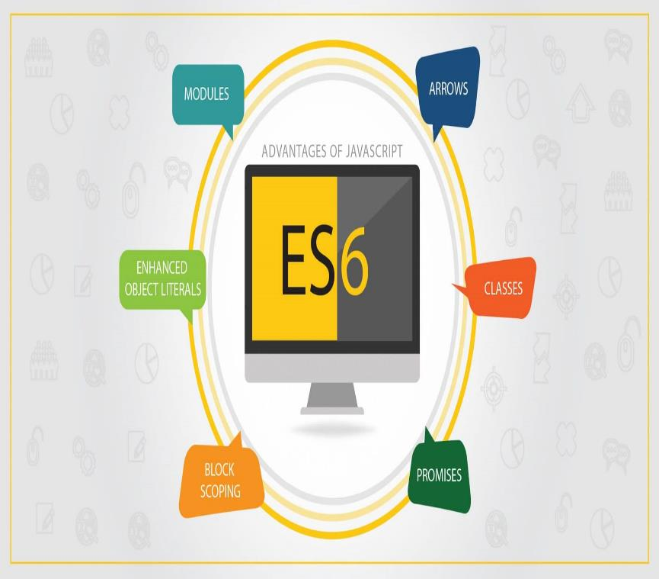
Learning 2| My Takeaways
→ TypeScript
→ ES6
→ Template Literals
→ Generics

Slide 6
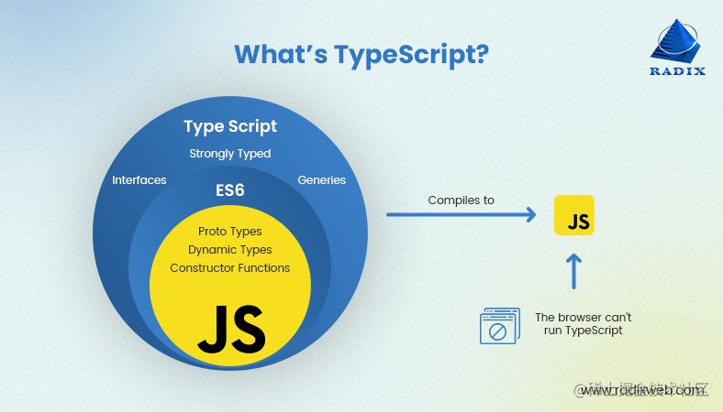
TypeScript:
TypeScript is a superset of JavaScript that adds static typing to your code.
Ex:
function greet(name: string): string {
return "Hello, " + name;
}
ES6:
ES6 is the 6th version of ECMAScript,
the language standard behind JavaScript.
features like :let ,const,arrow functions,Default parameter,
spread,Modules,Promises.
Template-Literals:Template literals let you create strings with embedded expressions using backticks.
ex: const name = "Jeff";
const greeting = `Hello, ${name}!`;
→use backticks (`) not quotes
→Insert variables or expressions inside ${..}
Generics:
function firstItem<T>(arr: T[]): T {
return arr[0];
}
const first = firstItem<string>(["a", "b", "c"]); // "a"
S

Slide 7
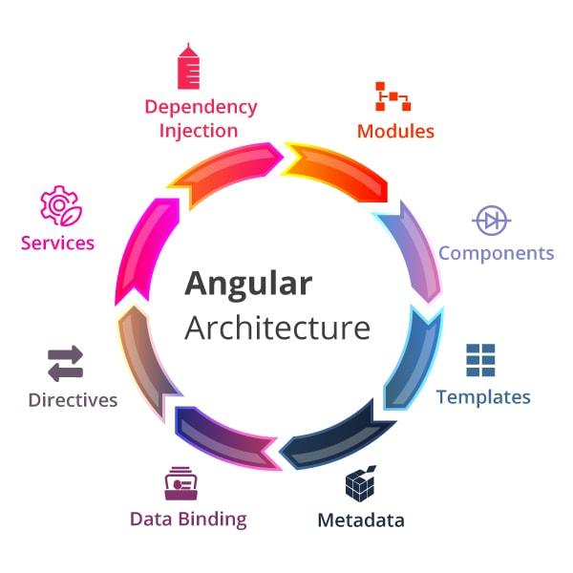
Learning 3| My takeaways
→Angular
→Creation of Angular Application
→Component Creation
→Directives(*ng-for,*ng-If)

Slide 8
Angular: Angular is a frontend javascript based framework.it is used to develop UI and Single page Applications.
Creation of Angular Application:
→Installation: npm install@ angular/cli
→creation: ng new application_name
→run: ng serve –open
Component Creation: We can create the component in two ways.
1)Manually
2)Angular/cli(by using: ng g c component name)
Directives(*ng-if and *ng-for):
1)ng-if:
Ex: <div *ngIf="isLoggedIn">
Welcome back!
</div>
2)ng-for:
<div *ngIf="items.length > 0">
<div *ngFor="let item of items">
{{ item }}
</div>
</div>

Slide 9
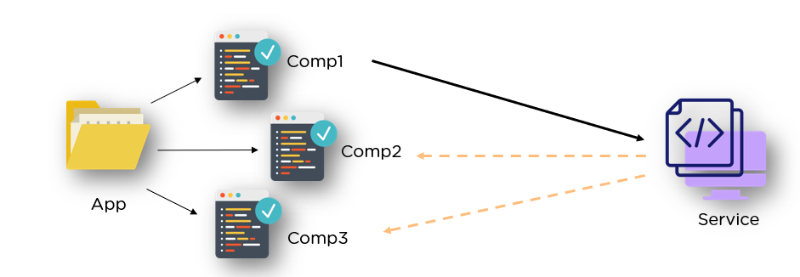
Learning 4 | takeaways
→Decorators(Input and Output)
→Template variable
→Two way Data-Binding(ng-model)
Services

Slide 10
Decorators (Input AND Output):
In Angular the terms @input() and @output() are officially used decorators to handle component communication, especially between parent and child components.
→Input: To transfer the data from parent to child.
→Output:To transfer the data from Child o parent.
Template variable: Template variable is a placeholder in a template (HTML, XML, or other markup) that gets dynamically replaced with actual values when the template is rendered. They're often used in server-side rendering engines or frontend frameworks.
ng-model: Is a directive in Angular that enables two-way data binding between form inputs and component properties.
Ex:-
<input [(ngModel)]="username" />
<p>Hello, {{ username }}</p>
Services:
A service is a reusable class or module that contains business logic, data access logic, or utility functions. It's designed to separate concerns, keeping components/controllers clean and focused on presentation or routing.
→Share data and logic across components
→Handle HTTP requests (e.g., to an API)
→Encapsulate business rules

Slide 11
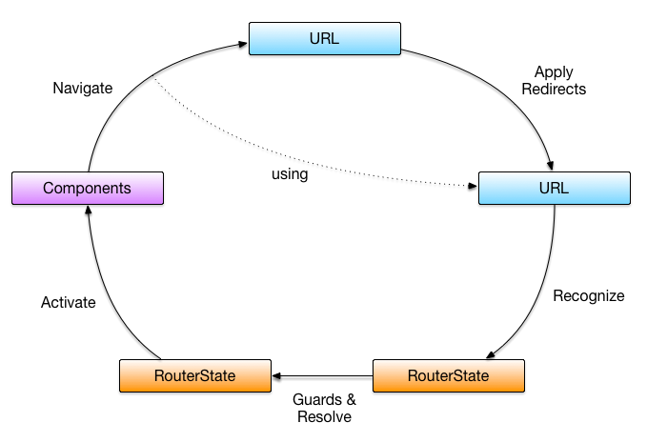
Learning 5 | takeaways
→Forms
→Observable
→Router Link
→RouteGuards

Slide 12
Forms:
Angular offers powerful tools for handling forms, and there are two main approaches.
1)Template-Driven Forms
2)Reactive Forms
Observable: An Observable is a data stream that can emit multiple values over time—kind of like a "push-based" collection. You can subscribe to it to receive updates, just like tuning into a radio station.
→It’s part of the RxJS (Reactive Extensions for JavaScript) library, which Angular uses heavily, especially for handling async tasks like HTTP requests, form events, and more.
RouterLink:
It is a directive that binds a link or button to a route path in your app. It replaces the traditional
<a href=“ ”> and works with Angular’s RouterModule for client-side navigation.
Ex:-<a routerLink="/dashboard">Go to Dashboard</a>
Route Guards:
Let you control whether a user can access or leave a specific route in your Angular application.
Can activate and can deactivate: These are two of the most commonly used Route Guards in Angular for handling access control and exit confirmation.

Slide 13

Learning 6 |takeaways
→Essentials of Written communication
→Informal and formal Words
→Email Writing
→Chat Etiquette

Slide 14
Essentioals Strong written communication:
Essentioals Strong written communication is essential for clarity, professionalism, and impact.
→Clarity
→Purpose
→Audience Awareness
→Correctness
→Conciseness
→Structure and flow
Informal and formal Words:
List of informal vs formal words often used in writing, especially useful when switching between casual chats and professional communication.
hi ----------hello
Ask --------inquire
check-------verify
get -------obtain
Email writing:
Subject Line – Clear and meaningful
Greeting – Choose formal or informal based on the reader
Opening Line – State the purpose right away
Body – Provide details in a clear and organized way
Chat etiquette:
Chat etiquette is super important, especially in professional settings like Slack, Teams, or WhatsApp groups

Slide 15
Thank You

